Slide 1
CFWI RWSP Team Update
Steering Committee
July 18, 2017
Tammy Bader, SJRWMD
Regional Water Supply Plan Team
www.cfwiwater.com

Slide 2
CFWI RWSP Team Updates
  Schedule
  BEBR Update
  Website Update
  Agricultural Demands
  Next Steps
  Questions
Notes:
Today I will give a brief update on the regional water supply plan schedule, the contract and work with the Bureau of Economic and Business Research, the Central Florida Water Initiative website, the methodology for agricultural water demand projections and the Regional Water Supply Plan Team’s next steps. These items presented today are all for informational purposes.

Slide 3
Schedule
2020 | Key Components | Start | End
Regional Water Supply Plan | ECFTX Model Completion | 1/1/2015 | 12/30/2017
 | Develop population and water demand projections – tabular and spatial distribution | 1/1/2015 | 12/31/2017
 | Per Guiding Principle 3 – Develop consistent rules (Regulatory Team) | 4/1/2016 | 12/31/2016
 | Update water conservation and reclaimed water estimates and options | 4/1/2016 | 12/31/2018
 | Update water supply and water resource development project options | 12/15/2017 | 8/16/2018
 | Evaluate and assess water sources | 12/31/2017 | 9/8/2018
 | Produce Draft 2020 Regional Water Supply Plan (first internal draft 6/4/2019) | 4/30/2019 | 10/9/2020
 | Conduct public workshops and meetings on the Draft 2020 Regional Water Supply Plan | 2/03/2020 | 10/20/2020
 | Governing Board Approvals | 10/13/2020 | 10/20/2020
Update the ECFT Model to better represent current and future hydrologic conditions in the CFWI Area to assist in planning and future regulatory applications
Notes:
We are currently on track with our schedule to have the East Central Florida Transient Extended Groundwater Flow Model and water demand projections completed by the end of this year. The Regional Water Supply Plan team is working with the Communications Team to set-up a workshop in November or December of this year to go over the water demand projections and methodologies employed. We have recently deployed a reclaimed water subteam to update those flow projections and potential projects. We anticipate an initial draft of the 2020 plan in early 2019, followed by workshops and additional public outreach.

Slide 4
BEBR Status
Parcel level population for CFWI
Contract executed March 27, 2017
Project schedule of 7 months
Final deliverable October 31, 2017
Notes:
As you may recall, in July 2016, the Steering Committee approved all of the projection methods with the exception of agriculture. Part of this was the approval to contract with the Bureau of Economic and Business Research to develop parcel level population projections for the Central Florida Water Initiative Regional Water Supply Planning Area. BEBR publishes yearly estimates and projections of population at the county level, which the districts must consider in water supply planning via F.S. The contract, which was executed in March of 2017 has a duration of seven months, allows BEBR to refine their county level projections into the level needed for the CFWI RWSP. Our final deliverable is scheduled for this October.
The cost is $120,000, split evenly between the three districts.

Slide 5
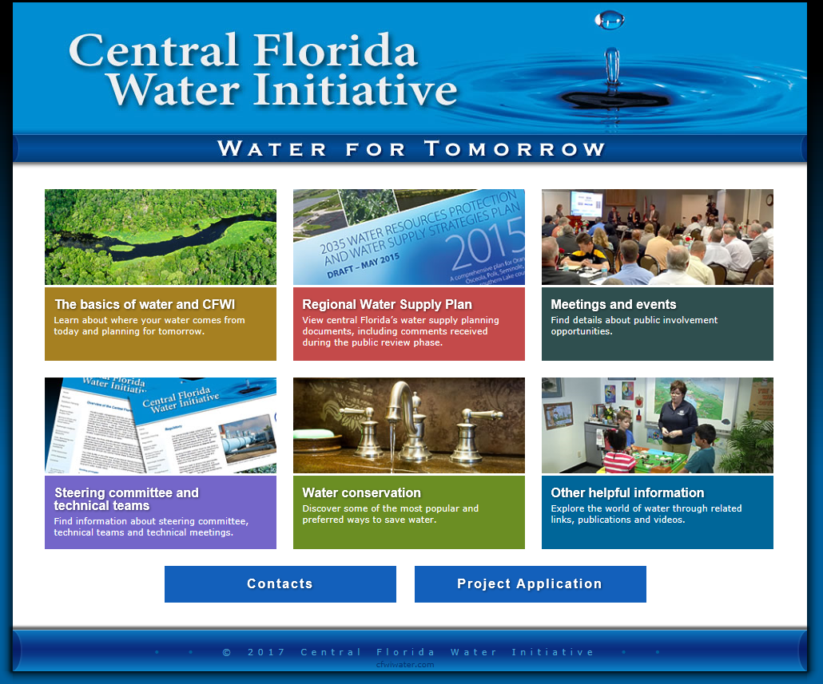
Website Update
Change basics tab to reflect current CFWI news and happenings
Notes:
For our Central Florida Water Initiative website, we are investigating updating the Basics link and project application link. The hope is to change it to reflect current Central Florida Water Initiative news and happenings. This will allow us to better communicate with the public and stakeholders regarding our progress of the 2020 plan and resource evaluations.

Slide 6
Water Demand Methods for Planning
Agricultural
FSAID IV acreage and water demand projections in CFWI planning area (373.709, F.S.)
Incorporate North Ranch Sector Plan
Monthly time series generated with AFSIRS
Notes:
Section 373 of Florida Statutes requires that in water supply planning, the districts shall consider water supply demands provided by the Florida Department of Agriculture and Consumer Services. The Florida Department of Agriculture and Consumer Services’ product, known as the Florida Statewide Agricultural Irrigation Demand was provided on June 30th. This fourth version contains acreage and water demand projections through 2040. The RWSP Team will use the projections from the FSAID IV deliverable for the CFWI planning area. One variation, in water supply planning, the districts are required to incorporate information from any approved sector plans. In 2014, the North Ranch Sector Plan for Deseret in Osceola County was approved. Unfortunately, version 4 of the Florida Statewide Agricultural Irrigation Demand did not incorporate the agricultural water demand projections from the approved sector plan. There will be a variation from FSAID IV in Osceola County to account for the sector plan demands. Deseret is continuing to Collaboratively with FDACS and Balmoral to incorporate the sector plan demands into future versions of the FSAID. Of note, any variation, per statue, requires the districts to explain the deviation and present the Florida Department of Agriculture and Consumer Services’ projections along with the adjusted data in the RWSP. For groundwater modeling needs, these annual water demand projections will be translated using AFSIRS to create the monthly time series required for modeling. A write-up will be included in the RWSP to explain the differences between planning demands and permitted quantities for agriculture.

Slide 7
Next Steps
Finalize water demand projections in CFWI
Water demand projections outside CFWI
Workshop on projections – Nov/Dec
Begin update to AWS projects
Develop outline for RWSP
Draft initial RWSP chapters
Notes:
Moving forward, the RWSP team is working to finalize the water demand projections in the Central Florida Water Initiative Regional Water Supply Planning Area. We are in the process of determining the water demand projections outside the Central Florida Water Initiative Regional Water Supply Planning Area, but within the East Central Florida Transient Extended Groundwater Flow Model boundary. As mentioned previously, outreach and workshops are being planned for late November or early December to provide an overview of the water demands and projection methodologies, as well as to garner stakeholder input and buy-in. We will be forming a subteam to update the alternative water supply and water resource development projects for the 2020 CFWI RWSP, including the projects listed in the North Ranch Sector Plan. Also, on our upcoming agenda is to create a draft outline for the 2020 CFWI RWSP and draft some of the initial chapters.

Slide 8
Questions?
Notes:
That concludes my update on the Regional Water Supply Plan Team’s progress. I would be happy to answer any questions that you may have.

